Slide 1

COURSE PROJECT COMPUTER ORGANIZATION AND ARCHITECTURE
(CS2007)
BRANCH-BASED INSTRUCTION PREFETCHER
Advanced Instruction Stream Optimization for Modern Pipelines

Slide 2
Team Details
I V S Akhil – CS24B2005
B Rakesh – CS24B2039
K Siva Phanendra – CS24B2048
L Guna – CS24B2043

Slide 3
Problem Statement
The objective is to design and implement a Verilog hardware module that autonomously detects ARM branch instructions in the instruction stream, calculates their target ad-dresses, and prefetches those target instructions from memory into a low-latency buffer , thereby hiding the memory access latency from the processor.

Slide 4

The Problem
The Memory Wall: CPUs execute instructions orders of magnitude faster than main memory can provide them, creating a fundamental latency bottleneck.
The Branch Penalty: ARM control-flow instructions stall the pipeline until the target address is decoded and fetched, wasting precious clock cycles.
Pipeline Stalls: During target calculation, the pipeline starves. Once calculated, a second stall occurs while waiting for the memory controller to respond.

Slide 5



Approach & Architecture
Snoop
Predict
Fetch
Passively monitors instruction fetching on the primary bus without interrupting the CPU core.
Immediately identifies branch opcodes and calculates jump destinations in raw hardware logic.
Proactively requests the target instruction from memory via AXI before the CPU even requests it.

Slide 6
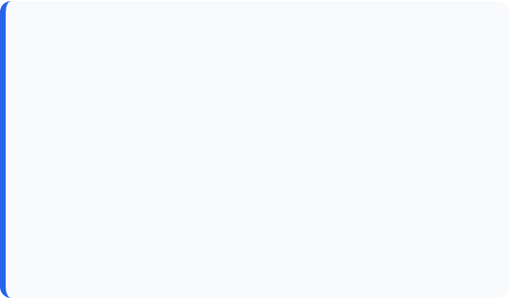

Implementation: Pre-decoder
Combinational Detection
Instant Offset Math
Pure logic block monitoring the instruction bus. It validates bits [27:25] for the ARM branch opcode (101) while filtering out condition code 1111.
Calculates the relative target PC in one cycle: Target = (PC + 8) + (SignExt(Offset) << 2)
The result is a valid target address available in the same clock cycle the branch is detected.

Slide 7
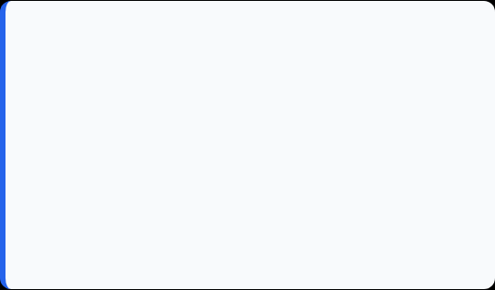

Implementation: Prefetcher & FIFO
AXI Master FSM
Sidecar FIFO
A high-performance 3-state machine (IDLE → REQ → WAIT) that manages arvalid handshakes and data retrieval from the memory bus.
An 8-deep circular queue storing 64-bit payloads (PC + Instruction). Uses N+1 Pointers to resolve full vs. empty ambiguity.

Slide 8
Implementation: Memory Arbiter
Bus Multiplexing: Implements a strict 9-state arbiter to manage contention between the CPU and Prefetcher, prioritizing the CPU at all times.
The Hit Path: Bypasses main memory entirely if the requested address is found in the Sidecar FIFO, serving data instantly.
The Miss Path: Seamlessly routes the CPU's request directly to the AXI memory bus when prefetch data is not available.

Slide 9
Challenges We Faced
AXI Synchronization
Handling Mispredictions
Ensuring READY/VALID alignment across three domains (CPU, Arbiter, Memory) was critical to avoid permanent bus deadlocks.
If a branch isn't taken, the FIFO holds invalid data. We implemented a 1-cycle asynchronous flush to wipe pointers instantly.

Slide 10
Final Results & Verification
Zero-Latency Fetching: Testbench analysis confirmed that predicted instructions are served directly from the FIFO with zero memory wait cycles.
Verified Waveforms: Waveform logs prove mem_arvalid is suppressed during hits, successfully reducing power and bus congestion.
Fault Tolerance: Simulation of branch mispredictions resulted in successful 1-cycle recoveries with 100% data integrity maintained.

Slide 11
THANK YOU

